Slide 1
CENTRAL TENDENCY & DISPERSION

Slide 2
Survey Items
Nominal Measurement
Good
What college (e.g., CLA, CHESP) are you enrolled in?
Not as good
Are you a freshman, sophomore, junior, or senior?
What is your college major?
Political affiliation/Religion

Slide 3
Survey Items
Ordinal
Mostly Likert-type
Freshman, sophomore….
How far do you live from campus (0-5 miles…)
Interval/Ratio
GPA
Hours study per week
Number of credits carried

Slide 4
Review
Class Exercise:
Professor Numbscull surveys a random sample of Duluth residents. He wants to know if age predicts the support for banning so-called “synthetic marijuana” products (very supportive, somewhat supportive, not supportive).
What are the IV and DV—what is their level of measurement?

Slide 5
Ratios/Proportions/Percents
What percent of people enjoy fishing?
What is the ratio of Ford F-150 owners to Toyota Prius Owners?
What proportion of those who do not enjoy fishing drive a Honda Accord?
Type of Vehicle | Enjoy Fishing | Do not enjoy Fishing | TOTAL
Honda Accord | 11 | 14 | 25
Ford Escort | 33 | 10 | 43
Toyota Prius | 3 | 8 | 11
Ford F-150 Truck | 41 | 2 | 43
TOTALS | 88 | 34 | 122

Slide 6
SPSS CODING
ALWAYS do “recode into different variable”
INPUT MISSING DATA CODES
Variable labels
Check results with original variable
Useful to have both numbers and variable labels on tables
EDIT→OPTIONS→OUTPUT→PIVOT TABLES→ Variable values in label shown as values and labels

Slide 7
Class Exercise
Recode a variable from GSS
Create a variable called “married_r” where:
0 = not married
1 = married
Be sure to label your new variable!
Run a frequency distribution for the original married variable and “married_r”

Slide 8
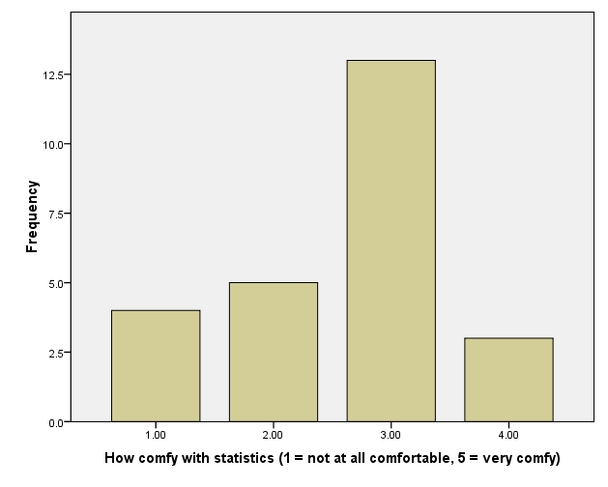
Distribution of Scores
All the observations for any particular sample or population
Notes:
Examples:

Slide 9
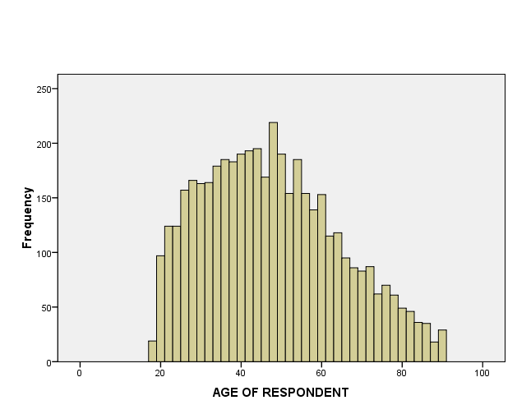
Distribution (GSS Histogram)

Slide 10
Exercise
Create your own histogram from the GSS data using the variable “TVHOURS”
Concept of “skew”
Positive vs. negative
Skew is only possible for ordered data, and typically relevant for interval/ratio data

Slide 11
Measures of Central Tendency
Purpose is to describe a distribution’s typical case – do not say “average” case
Mode
Median
Mean (Average)

Slide 12
Measures of Central Tendency
Mode
Value of the distribution that occurs most frequently (i.e., largest category)
Only measure that can be used with nominal-level variables
Limitations:
Some distributions don’t have a mode
Most common score doesn’t necessarily mean “typical”
Often better off using proportions or percentages

Slide 13
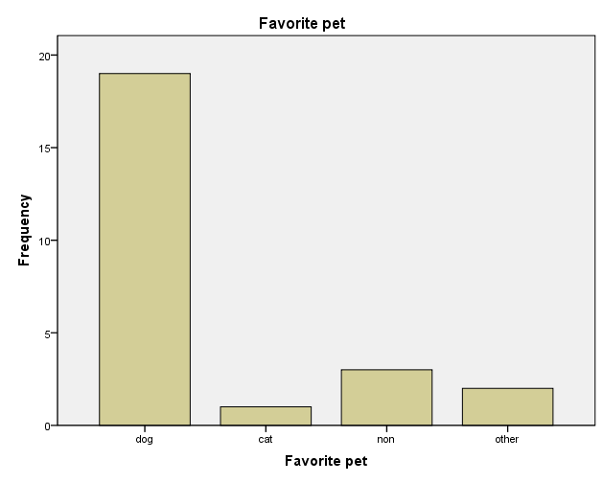
Measures of Central Tendency

Slide 14
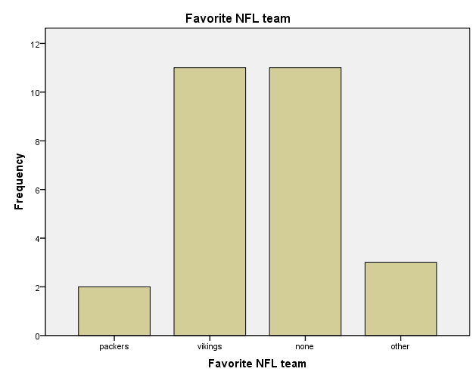
A more ambiguous mode

Slide 15
Measures of Central Tendency
2. Median
value of the variable in the “middle” of the distribution
same as the 50th percentile
When N is odd #, median is middle case:
N=5: 2 2 6 9 11
median=6
When N is even #, median is the score between the middle 2 cases:
N=6: 2 2 5 9 11 15
median=(5+9)/2 = 7

Slide 16
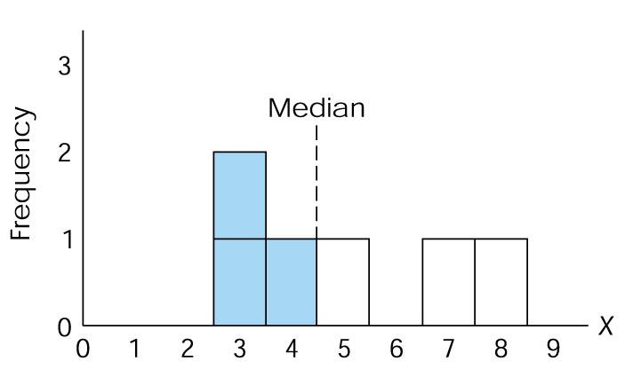
MEDIAN: EQUAL NUMBER OF CASES ON EACH SIDE

Slide 17
Measures of Central Tendency
3. Mean
The arithmetic average
Amount each individual would get if the total were divided among all the individuals in a distribution
Symbolized as X
Formula: X = Σ(X_{i} )
N

Slide 18
Measures of Central Tendency
Characteristics of the Mean:
It is the point around which all of the scores (X_{i}) cancel out. Example:
X | (X_{i} – X)
3 | 3 – 7 | -4
6 | 6 – 7 | -1
6 | 6 – 7 | -1
9 | 9 – 7 | 2
11 | 11- 7 | 4
ΣX = 35 | Σ(X_{i} – X) = | 0

Slide 19
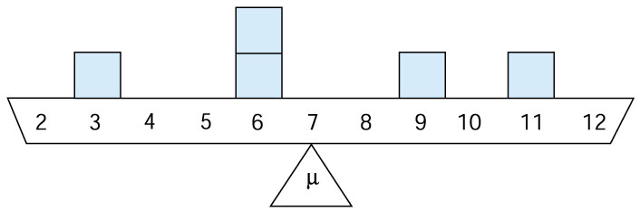
Mean as the “Balancing Point”
X
Notes:
Think of the values in the previous slide as weights
Think of the mean as the point at which the weights would be balanced.

Slide 20
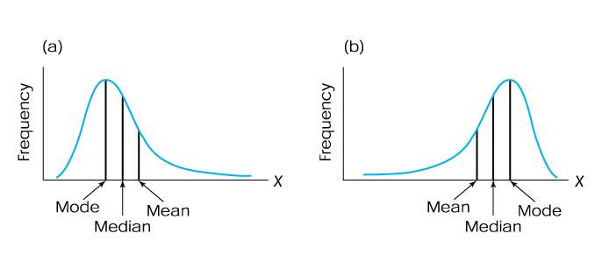
Measures of Central Tendency
Characteristics of the Mean:
2. Every score in a distribution affects the value of the mean
As a result, the mean is always pulled in the direction of extreme scores
Example of why it’s better to use MEDIAN family income
POSITIVELY SKEWED
NEGATIVELY SKEWED

Slide 21
Measures of Central Tendency
In-class exercise:
Find the mode, median & mean of the following numbers:
8 4 10
2 5 1
6 2 11
2
Does this distribution have a positive or negative skew?

Slide 22
Measures of Central Tendency
Levels of Measurement
Nominal
Mode only (categories defy ranking)
Often, percent or proportion better
Ordinal
Mode or Median (typically, median preferred)
Interval/Ratio
Mode, Median, or Mean
Mean if skew/outlier not a big problem (judgment call)

Slide 23
Measures of Dispersion
Measures of dispersion
provide information about the amount of variety or heterogeneity within a distribution of scores
Necessary to include them w/measures of central tendency when describing a distribution

Slide 24
Measures of Dispersion
Range (R)
The scale distance between the highest and lowest score
R = (high score-low score)
Simplest and most straightforward measure of dispersion
Limitation: even one extreme score can throw off our understanding of dispersion

Slide 25
Measures of Dispersion
2. Interquartile Range (Q)
The distance from the third quartile to the first quartile (the middle 50% of cases in a distribution)
Q = Q₃ – Q₁
Q₃ = 75% quartile
Q₁ = 25% quartile
Example: Prison Rates (per 100k), 2001:
R = 795 (Louisiana) – 126 (Maine) = 669
Q = 478 (Arizona) – 281 (New Mexico) = 197
25%
50%
75%
126
281
366
478
795

Slide 26
MEASURES OF DISPERSION
Problem with both R & Q:
Calculated based on only 2 scores

Slide 27
MEASURES OF DISPERSION
Standard deviation
Uses every score in the distribution
Measures the standard or typical distance from the mean
Deviation score = X_{i} - X
Example: with Mean= 50 and X_{i} = 53, the deviation score is 53 - 50 = 3

Slide 28
The Problem with Summing Deviations From Mean
2 parts to a deviation score: the sign and the number
Deviation scores
add up to zero
Because sum of deviations
is always 0, it can’t be
used as a measure of
dispersion
X X_{i} - X
8 +5
1 -2
3 0
0 -3
12 0
Mean = 3
Σ

Slide 29
Average Deviation (using absolute value of deviations)
Works OK, but…
AD = Σ |X_{i} – X|
N
X |X_{i} – X|
8 5
1 2
3 0
0 3
12 10
AD = 10 / 4 = 2.5
X = 3
Absolute Value to get rid of negative values (otherwise it would add to zero)

Slide 30
Variance & Standard Deviation
Purpose: Both indicate “spread” of scores in a distribution
Calculated using deviation scores
Difference between the mean & each individual score in distribution
To avoid getting a sum of zero, deviation scores are squared before they are added up.
Variance (s²)=sum of squared deviations / N
Standard deviation
Square root of the variance
X_{i} | (X_{i} – X) | (X_{i} - X)²
5 | 1 | 1
2 | -2 | 4
6 | 2 | 4
5 | 1 | 1
2 | -2 | 4
Σ = 20 | Σ = 0 | Σ = 14

Slide 31
Terminology
“Sum of Squares” = Sum of Squared Deviations from the Mean = Σ (X_{i} - X)²
Variance = sum of squares divided by sample size = Σ (X_{i} - X)² = s²
N
Standard Deviation = the square root of the variance = s

Slide 32
Calculation Exercise
Number of classes a sample of 5 students is taking:
Calculate the mean, variance & standard deviation
mean = 20 / 5 = 4
s² (variance)= 14/5 = 2.8
s= √2.8 =1.67
X_{i} | (X_{i} – X) | (X_{i} - X)²
5 | 1 | 1
2 | -2 | 4
6 | 2 | 4
5 | 1 | 1
2 | -2 | 4
Σ = 20 | 0 | 14

Slide 33
Calculating Variance, Then Standard Deviation
Number of credits a sample of 8 students is are taking:
Calculate the mean, variance & standard deviation
X_{i} | (X_{i} – X) | (X_{i} - X)²
10 | -4 | 16
9 | -5 | 25
13 | -1 | 1
17 | 3 | 9
15 | 1 | 1
16 | 2 | 4
14 | 0 | 0
18 | 4 | 16
Σ = 112 | 0 | 72
Notes:
AGAIN, A SMALL NUMBER OF CASES. IN THIS CASE, N=8
Calculate the variance & standard deviation of these 8 scores.
MEAN = 14 (112 / 8)
VARIANCE = SUM OF SQUARED DEVIATIONS/# OF SCORES
72 / 8 = 9
Standard deviation = sq. rt. of variance

Slide 34
Summary Points about the Standard Deviation
Uses all the scores in the distribution
Provides a measure of the typical, or standard, distance from the mean
Increases in value as the distribution becomes more heterogeneous
Useful for making comparisons of variation between distributions
Becomes very important when we discuss the normal curve (Chapter 5, next)
Notes:
1 – Like the mean in this sense
2 – Good index of variation
3 – Another form of standardization (putting things into a common metric, just like %s or rates)
Becomes very important when we discuss the normal curve (Chapter 5, next)
4 – Read Chapter 5 for next time

Slide 35
Mean & Standard Deviation Together
Tell us a lot about the typical score & how the scores spread around that score
Useful for comparisons of distributions:
Example:
Class A: mean GPA 2.8, s = 0.3
Class B: mean GPA 3.3, s = 0.6
Mean & Standard Deviation Applet

